Slide 1
INSURANCE MANAGEMENT SYSTEM

Slide 2
Table name: admin
FIELD | DATA TYPE | SIZE | CONSTRAINT
Username | Varchar | 10 | Not null
Password | Varchar | 5 | Not null

Slide 3
TABLE NAME: AGENT
FIELD | DATA TYPE | SIZE | CONSTRAINT
Agent id | Int | 5 | Primary key
First name | Varchar | 10 | Not null
Last name | Varchar | 10 | Not null
D.O.B | Date | 8 | Not null
Gender | Varchar | 5 | Not null
Mobile no | Int | 10 | Not null
Age | Int | 2 | Not null
State | Varchar | 20 | Not null
City | Varchar | 20 | Not null
Pincode | Int | 7 | Not null
Address | Varchar | 30 | Not null
Experience | Int | 2 | Not null
Password | Varchar | 5 | Not null

Slide 4
TABLE NAME: customer
FIELD | DATA TYPE | SIZE | CONSTRAINT
Customer id | Int | 5 | Primary key
First name | Varchar | 10 | Not null
Last name | Varchar | 10 | Not null
D.O.B | Date | 8 | Not null
Gender | Varchar | 7 | Not null
Age | Int | 2 | Not null
Mobile.no | Int | 10 | Not null
State | Varchar | 15 | Not null
City | Varchar | 20 | Not null
Pincode | Int | 7 | Not null
Address | Varchar | 20 | Not null
Occupation | Varchar | 10 | Not null
Agent id | Int | 5 | Not null

Slide 5
TABLE NAME: POLICY
FIELD | DATA TYPE | SIZE | CONSTRAINT
Policy id | Int | 5 | Not null
Policy name | Varchar | 20 | Not null
Policy category | Varchar | 20 | Not null
Policy duration | Int | 2 | Not null
Policy status | Varchar | 10 | Not null
Policy date | Date | 8 | Not null
Policy expiry date | Date | 8 | Not null
Amount | Int | 7 | Not null

Slide 6
Table name: payment
FIELD | DATA TYPE | SIZE | CONSTRAINT
Payment id | Int | 5 | Primary key
Policy id | Int | 5 | Foreign key
Customer id | Int | 5 | Foreign key
Agent id | Int | 5 | Foreign key
Last payment | Int | 7 | Not null
Remaining amount | Int | 7 | Not null

Slide 7
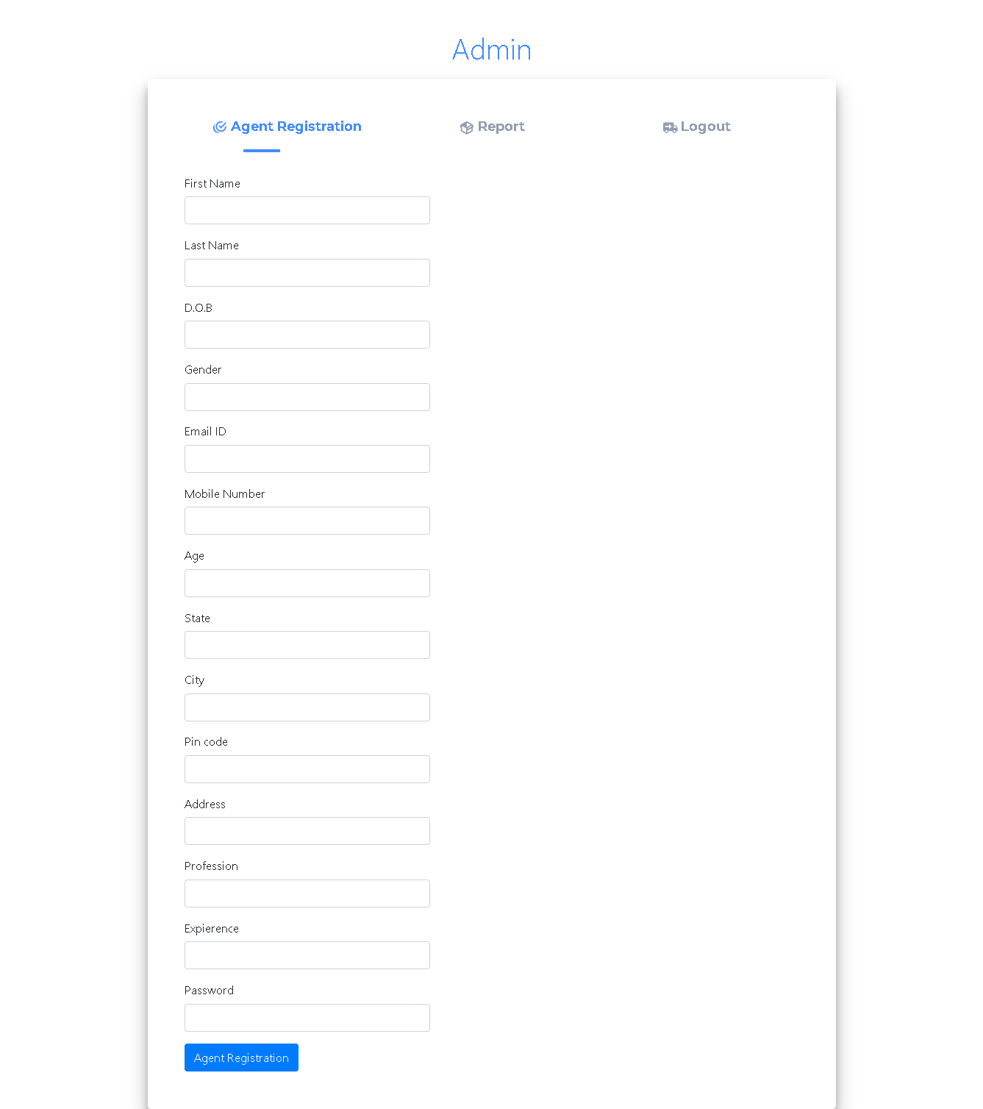

Slide 8
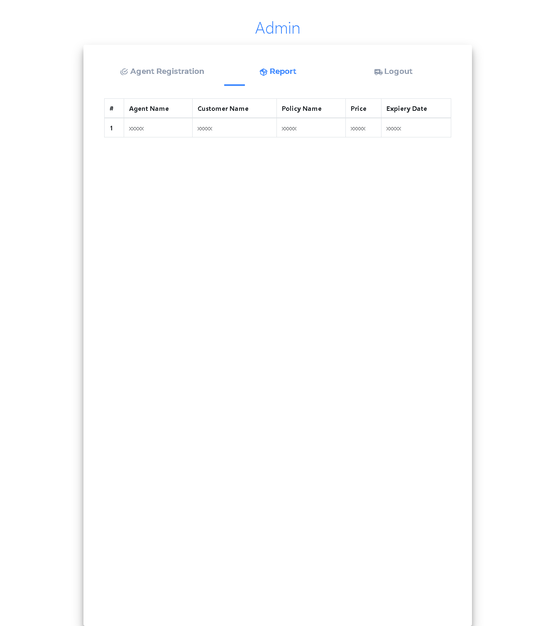

Slide 10
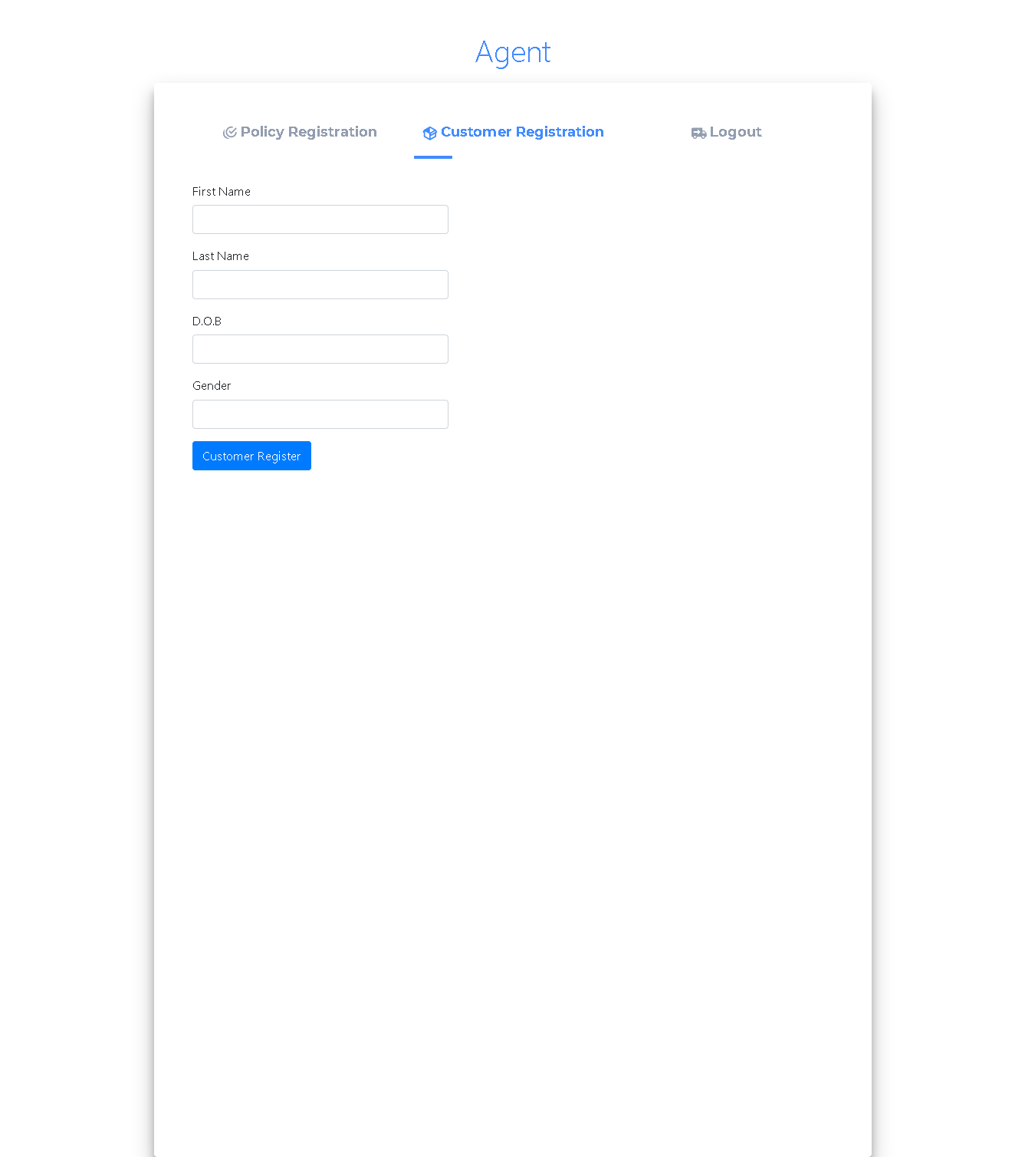

Slide 11
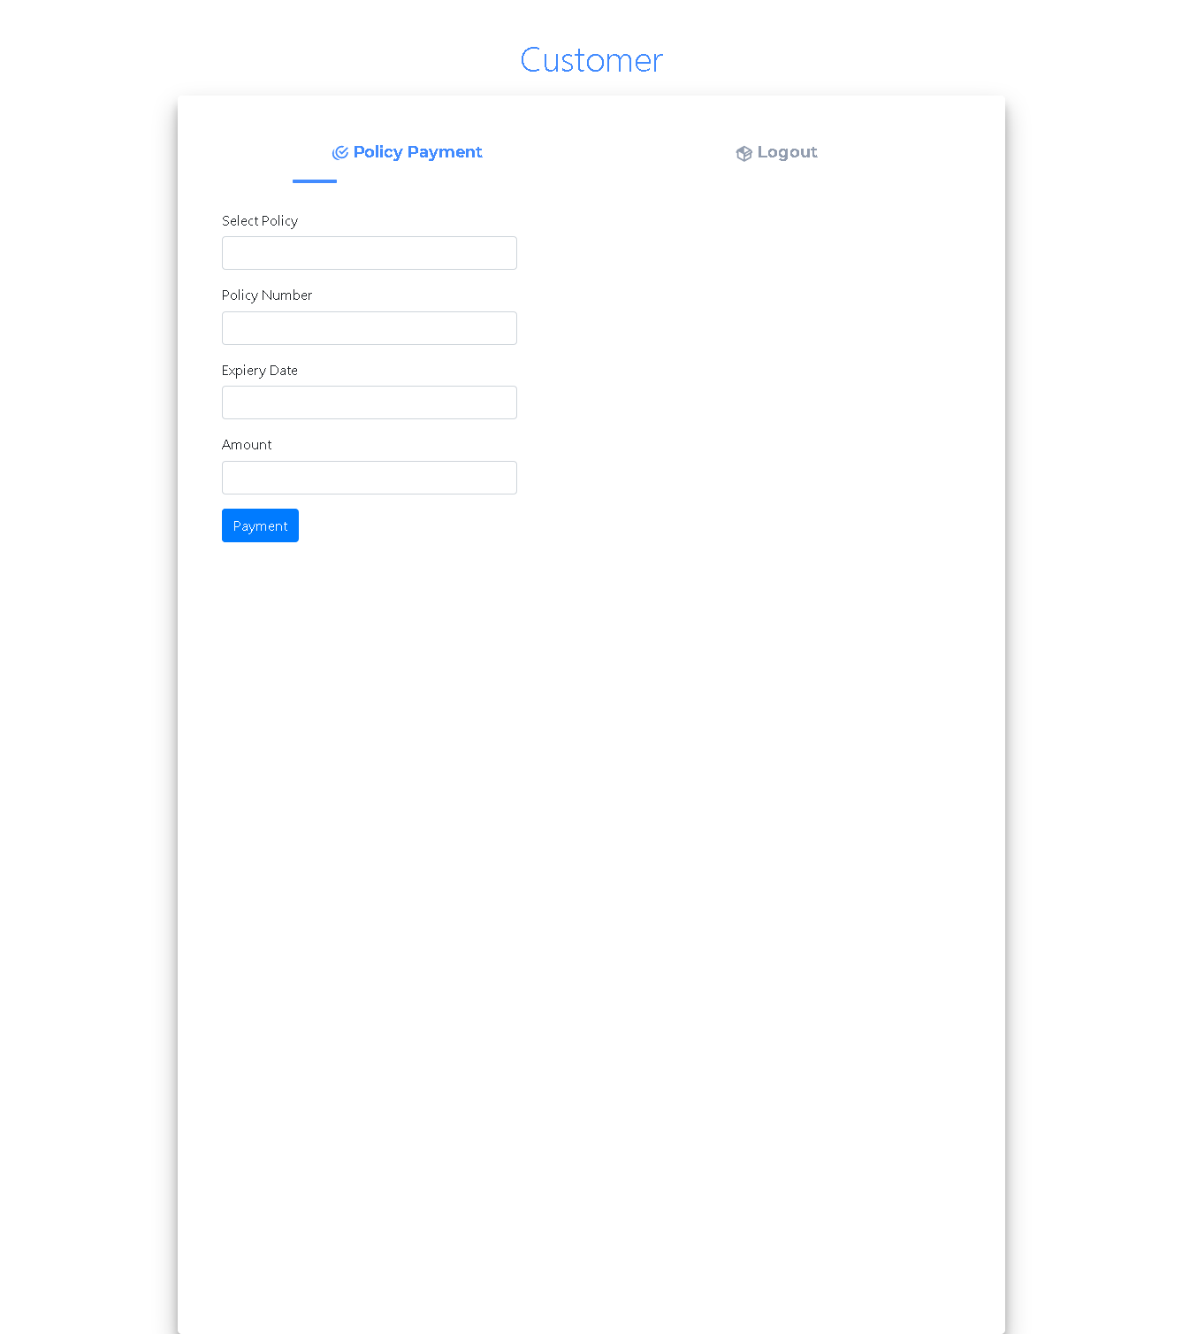

Slide 12
thank you

